Slide 1
Azure SQL Data Warehouse

Slide 2
Azure SQL DW initial, generation 1, platform architecture
Control
Cores
Memory
SSD TempDB
Compute
Cores
Memory
Cores
Memory
Cores
Memory
SSD TempDB
SSD TempDB
SSD TempDB
Remote Storage
Snapshot backups
Data
Log

Slide 3
Next Generation Architecture Adaptive caching
Control
Compute
Adaptive
Cache
Remote
Storage
Notes:
Cloud Data Warehouses break the mold by separating compute from storage
Store as much data as you want
Pay for the performance you require
SQLDW introduces an automated cache that keeps a copy of your data close to the CPUs to maximise performance

Slide 4
Next Generation Architecture bottomless storage
Control
Cores
Memory
SSD TempDB
Cores
Memory
Cores
Memory
Cores
Memory
NVMe SSD
NVMe SSD
NVMe SSD
Compute
Cache
TempDB
Cache
TempDB
Cache
TempDB
Data
Remote storage
Snapshot backups
Log
Notes:
Non-Volatile Memory / Flash Memory hosting Cache and tempdb
NVM Express reduces I/O overhead and brings various performance improvements in comparison to previous logical-device interfaces, including multiple, long command queues, and reduced latency.

Slide 5
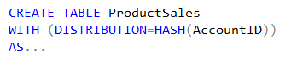
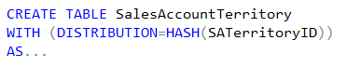
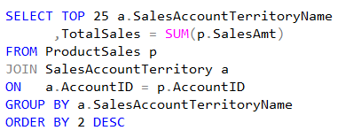
Distributed Data Movement
ProductSales
SalesAccountTerritory
AccountID | SalesAmt | …
47 | $1,234.36 | …
36 | $2,345.47 | …
14 | $3,456.58 | …
25 | $4,567.69 | …
48 | $5,678.70 | …
37 | $6,789.81 | …
… | … | …
SATerritoryID | AccountID | …
444 | 37 | …
333 | 25
111 | 36 | …
222 | 47 | …
445 | 14
334 | 48 | …
… | … | …
Node 1:
Node 2:
Node 3:
Node 4:
Node 5:
Node 6:
Shuffle
SATName | TotalSales
North | $6,789.81
South | $5,678.70
NorthEast | $4,567.69
SouthWest | $3,456.58
East | $2,345.47
West | $1,234.36
AccountID | SATName | …
47 | West | …
36 | East
14 | SouthWest | …
25 | NorthEast | …
48 | South
37 | North | …
… | … | …

Slide 6
Gen1 – Data Movement Service
SQL DW Compute Node 2
SQL Engine
Distributed Tables
TEMP DB
SQL DW Compute Node 1
SQL Engine
Data Movement Service
Distributed Tables
TEMP DB
SQL DW Compute Node 3
Data Movement Service
SQL Engine
Distributed Tables
TEMP DB
Stand-alone process, fixed memory
Single-threaded read – BulkCopy API
Copy is not scalable (cores and network)
Data Movement Service

Slide 7
Gen2 – instant data movement
SQL DW Compute Node 2
SQL Engine
Distributed Tables
SQL DW Compute Node 1
TEMP DB
SQL Engine
Distributed Tables
TEMP DB
SQL DW Compute Node 3
SQL Engine
Distributed Tables
Data does not leave SQL Engine
Batch-mode: minimal overhead
Scalable: leverages all cores and network
It’s Free!
TEMP DB

Slide 8
Industry Leading Performance

Slide 9
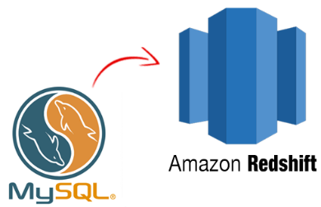



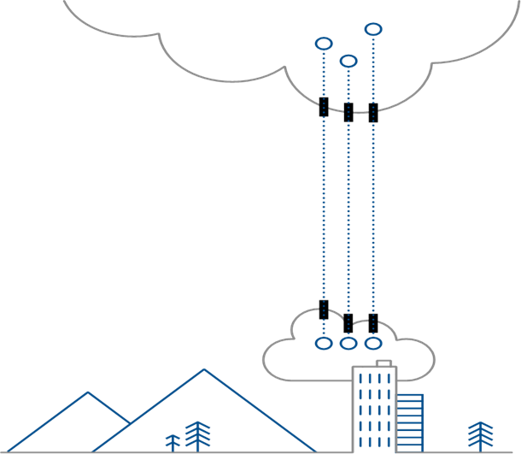

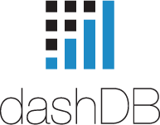
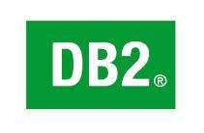
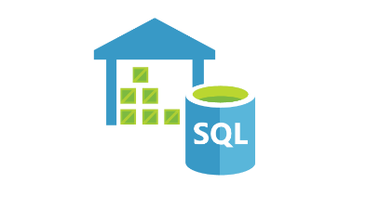



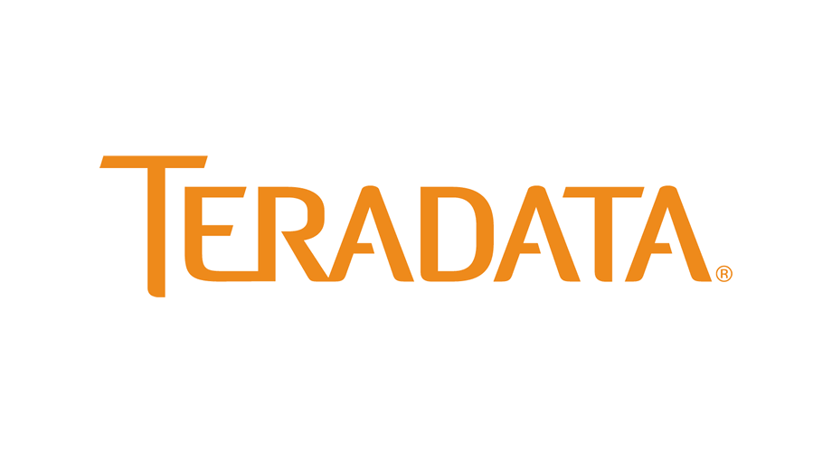


Market Breakdown
Cloud Data Warehouse
Cloud Competitors
Snowflake
Google BigQuery
Amazon Redshift
Hybrid Competitors
SAP HANA
Oracle Exadata
Teradata Database
IBM PureData | Db2 | dashDB | Big SQL
On-premises
Greenplum Database*
HPE Vertica*
*Primarily on-premises, but can be used on IaaS
Notes:
Will contain any Market related content

Slide 10
Hybrid and On-Premises Options
Platform | On-Premise Offering | Private Cloud Offering | Hybrid Offering | Comments
Azure DW | Yes (APS or SQL Server) | No | Yes (Azure Stack, SQL Stretch Database etc.) | The APS appliance is positioned for on premise use cases at the Petabyte scale, with SQL Server recommended for more typical scenarios. Azure Stack (currently in technical preview) allows customers to effectively run Azure and its services in their own datacenters, enabling a wealth of hybrid solutions.
Amazon Redshift | No | No | No | Hybrid scenarios can be enabled through 3rd party tools such as Informatica Cloud Services to integrate on-premises storage with AWS.
Snowflake | No | Yes | No | Snowflake takes great pride in being built specifically for the cloud.
dashDB | Yes (Db2 LUW, dashDB local or PureData) | Yes (Bluemix dedicated or local including dashDB) | Yes (dashDB Local) | IBM data warehousing is available as an on-premises appliance, through a private cloud using Bluemix dedicated with dashDB, or dashDB Local (Docker container) or on a managed cloud service Bluemix as dashDB.

Slide 11
Hybrid and On-Premises Options
Platform | On-Premises Offering | Private Cloud Offering | Hybrid Offering | Comments
Teradata Database | Yes (Teradata Database) | Yes (Managed Cloud) | Yes (Hybrid Cloud) | Teradata offer a wealth of options on-premises and in a managed private cloud. The private cloud option is relatively new so could have some problems.
Oracle Exadata | Yes | Yes | No | Oracle Exadata is available as an on-premises appliance or private cloud appliance. The cloud service is effectively the same appliance.
BigQuery | No | No | No | Only available on Google Cloud Platform.
HPE Vertica | Yes | No | No | HPE Vertica was initially an on-premises platform. The public cloud platform is effectively the same but running on AWS or Azure. HPE Vertica does offer the ability to synchronize data warehouses across AWS and Azure, though it is hard to see an effective use case for this feature.
Table of Contents

Slide 12
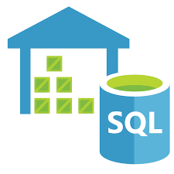
Azure SQL DW
A truly elastic cloud DW
SQL-based, fully managed, petabyte-scale cloud data warehouse with
independent elastic scaling in seconds.
Excellent price performance, especially if elastic workload
Elastic: Storage auto scales with no need to over provision
Elastic: Compute can be scaled at any time. DWs can be paused
Provides query over external data via PolyBase
Fully managed service
AD Authentication and MFA
Meets various industry compliance requirements and regulations e.g. PCI-DSS, SOX or HIPAA
Separating storage and compute does carry performance penalty (minimized with cache in Gen2)
No external encryption key store
Does not support explicit data sorting of column-store data
VNET is currently in preview
Elastic and independent scaling
SQL Compatibility
Microsoft Big Data ecosystem (ADF, Data Lake, HDInsight), Hybrid to on-premises SQL Server, APS)
Query over external data
Deep Dive | Table of Contents

Slide 13
Feature Comparisons

Slide 14
Start-up, Scale-up and Scale-out
 | Time to scale | Time to Restore | D/T to Scale | Can Pause | # of Data Centers | Max Storage
Azure DW | Minutes | Minutes | Seconds | Yes | 27 | Unlimited
Redshift | Hours | Hours | Hours | No | 16 | 2PB
Snowflake | Minutes | Seconds | 0 | Yes | Configurable | >1PB
IBM Db2 | Days | Hours | Minutes | No | 1 | 5TB
HANA | Days | Hours | Seconds | No | 5 | 1TB
Teradata | Seconds | Hours | Seconds | No | ? | 94PB
Exadata | Hours | Hours | Seconds | No | Up to 20 | 168TB
BigQuery | Seconds | ? | Seconds | Yes | 15 | >1PB
Greenplum | Days | Hours | Hours | No | Configurable | >1PB
IBM Big SQL | N/A | N/A | N/A | No | Configurable | > 1PB
N/A – Not applicable, check deep dive to understand the product
? – Could not find information
Table of Contents

Slide 15
Security
 | Object Level | Row Level | Multi-Factor Authentication | Audit Logging | Encryption
Azure DW | Yes | Coming Soon | Yes | Yes | Yes
Redshift | Yes | No | Limited | ? | Yes
Snowflake | Yes | No | Yes | ? | Yes
IBM Db2 | Yes | Yes | No | ? | Yes
HANA | Yes | Yes | Yes | Yes | Yes
Teradata | Yes | Yes | ? | Yes | Yes
Exadata | Yes | Yes | ? | Yes | Yes
BigQuery | No | No | No | Yes | Yes
Greenplum | Yes | No | No | Yes | Configurable
IBM Big SQL | Yes | Yes | Yes | Yes | Yes
N/A – Not applicable, check deep dive to understand the product
? – Could not find information

Slide 16
High Availability Downtime Under Failure
 | Disk Failure | Node Failure | DC Failure | # of Replicas | Geo-replicas
Azure DW | 0 | Minutes | ? | 6 | Yes
Redshift | 0 | Hours | Hours | 3 | No
Snowflake | 0 | 0 | Minutes | ? | No
IBM Db2 | 0 | Hours | Days | 3 | No
HANA | Limited | Hours | Days | ? | No
Teradata | 0 | Configurable | Hours | Configurable | No
Exadata | 0 | Seconds | Days | 3 | No
BigQuery | 0 | Seconds | ? | ? | Yes
Greenplum | 0 | Minutes | Hours | Configurable | No
IBM Big SQL | 0 | Configurable | Configurable | Configurable | Configurable
N/A – Not applicable, check deep dive to understand the product
? – Could not find information

Slide 17
Programmability and Tooling
 | UDFs/SPROCs | ODBC | JDBC | MDX/OLAP SQL | Spatial Types | In DB R/Python | Constraints | JSON/XML
Azure DW | Yes | Yes | Yes | Yes | No | No | No | No
Redshift | Yes | Yes | Yes | No | No | Yes | Yes | Yes
Snowflake | Yes | Yes | Yes | ? | No | No | Yes | Yes
IBM Db2 | Yes | Yes | Yes | No | Yes | Yes | Yes | Yes
HANA | Yes | Yes | Yes | ? | Yes | Limited | No | No
Teradata | Yes | Yes | Yes | ? | Yes | Configurable | Yes | Yes
Exadata | Yes | Yes | Yes | ? | Yes | Yes | Yes | Yes
BigQuery | Yes | Yes | Yes | Yes | No | No | No | Yes
Greenplum | Yes | Yes | Yes | Yes | Yes | Yes | Yes | Yes
IBM Big SQL | Yes | Yes | Yes | Yes | Yes | Yes | Yes | Yes
N/A – Not applicable, check deep dive to understand the product
? – Could not find information

Slide 18
Compliance
 | SLA | HIPAA | EU Safe Harbour | FedRAMP | PCI-DSS
Azure DW | Yes | Yes | Yes | Yes | Yes
Redshift | No | Yes | Yes | Yes | Yes
Snowflake | Yes | Yes | Yes | ? | ?
IBM Db2 | No | No | No | No | No
HANA | Yes | No | No | No | No
Teradata | Yes | ? | ? | ? | ?
Exadata | Yes | Yes | Yes | No | Yes
BigQuery | Yes | Yes | Yes | Yes | Yes
Greenplum | No | No | No | No | No
IBM Big SQL | ? | ? | ? | ? | ?
N/A – Not applicable, check deep dive to understand the product
? – Could not find information

Slide 19
Load and Unload
 | Parallel Load | Parallel Unload | External Query | Data Compression | D/C Coupled | Disk-Shipping
Azure DW | Yes | Yes | Yes | Yes | No | Yes
Redshift | Yes | Yes | Yes | Yes | Yes | Yes
Snowflake | Yes | Yes | No | Yes | No | Yes
IBM Db2 | ? | ? | No | Yes | Limited | Limited
HANA | No | No | No | Yes | Yes | Yes
Teradata | Yes | Yes | Yes | Yes | Yes | Yes
Exadata | Yes | Yes | Yes | Yes | Yes | ?
BigQuery | Yes | Yes | Yes | Yes | No | No
Greenplum | Yes | Yes | Yes | Yes | Yes | Configurable
IBM Big SQL | Yes | Yes | Yes | Yes | Configurable | Yes
N/A – Not applicable, check deep dive to understand the product
? – Could not find information

Slide 20
Data Structures
 | Partitioning | Indexing | Materialized Views | Row-Wise Support
Azure DW | Yes | Yes | No | Yes
Redshift | No | No | No | No
Snowflake | Yes | No | No | No
IBM Db2 | Yes | Yes | Yes | Yes
HANA | No | Yes | No | No
Teradata | Yes | Yes | Yes | Yes
Exadata | Yes | Yes | Yes | Yes
BigQuery | Yes | No | No | No
Greenplum | Yes | Yes | Yes | Yes
IBM Big SQL | Yes | Yes | Yes | Yes
N/A – Not applicable, check deep dive to understand the product
? – Could not find information
Table of Contents

